Slide 1
Digital to Analog and Analog to Digital Conversion of Audio
A Dan Turkel Production

Slide 2
What is sound?
Sound is a wave of pressure oscillation. Sound is measured in amplitude (the height of the wave, how loud it is) and frequency (how often the wave completes a cycle, it’s tone).

Slide 3
What is an analog signal?
A continuous signal with a time varying variable. They have an infinite resolution, which is to say, since they are completely continuous, any point in time on the wave has its own value X(t). Additionally, X(t) can be any value.

Slide 4
What is a digital signal?
A stream of data (usually in binary) that represents a series of discrete values. Time is represented in discrete values and each time can only have an X[n] value that is part of a certain set.

Slide 5
Analog to digital conversion
This is the process of taking an analog wave of sound and turning it into a data stream.
A major problem comes up though: each value of the function X has to be encoded in binary. That means it takes up memory to store sound files, but how much? How do we keep that amount of memory reasonably low?

Slide 6
Sample rate
Well one thing is that we can’t have an infinite amount of values like a continuous signal. So we sample the signal so that we only store an X value at certain time intervals. So if we are using a sampling rate of 10 Hz (ten times a second) we would have ten binary values for each second of audio instead of an infinite amount of samples for one second (not possible).

Slide 7
Bit depth
But that’s not the only problem. How big can each value be? It’s not possible to have space for any possible value. So we quantize the values, we assign them to values in a discrete set.
Each value needs to be the same amount of digits so if 1 and 10101 are both possible values, we need to represent them as 00001 and 10101, if 101010 is also a possible value, we need to use 000001, 010101 and 101010. So if the value can be any binary number, a value of one would have to be preceded by an infinite number of zeroes, and this would take infinite memory, so that’s not possible.
Instead, we limit the number of values possible. If the greatest value is 111111, then it goes from 000000, 000001, 000010 up to 111111 and each value takes up exactly 6 bits.

Slide 8
Summed up
So the basic principal of analog to digital conversion is limiting the amount of times we sample the audio and take a value and limiting what possible values each time could have.
Can you figure out how big 3 minutes of mono audio at 100 Hz and 8 bit depth is?

Slide 9
Answer
3 minutes * 60 seconds * 100 samples per second * 8 bits per sample = 144,000 bits or 18,000 bytes (there are 8 bits in a byte, cool!)

Slide 10
What do we actually use?
CD Quality: 44.1 kHz, signed 16 bit (-32,768 to 32,767), 2 channels
DVD-audio: 192 khz, 24 bit, 5.1 channels
Blu-ray: 192 kHz, 24 bit, 8 channels

Slide 11
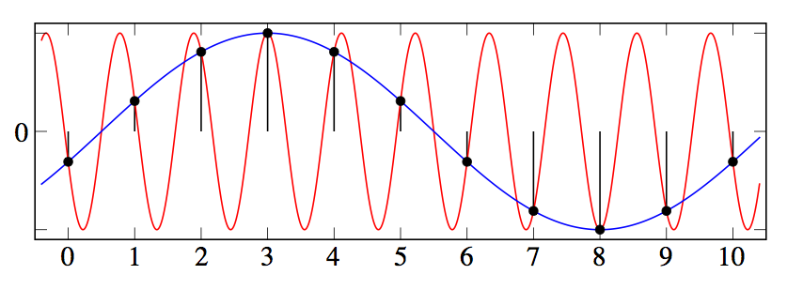
Nyquist Frequecy
The process of turning an analog signal digital creates problems. Take a look at this picture:

Slide 12
Nyquist Frequency, continued
A signal that contains, at its highest frequency, a B Hz wave, can be reconstructed as long as the sampling frequency is greater than 2B Hz.

Slide 13
Anti-aliasing filter
Before a signal goes through an ADC it as to be antialiased. An antialiasing filter reduces the amplitude of waves in the signal above a cutoff frequency (this is called a low-pass filter). This makes the Nyquist Frequency lower (since the highest frequency in the sample is lower) so it can be sampled at a smaller (more feasible) rate without aliasing (creating the wrong sound by sampling at a poor rate).

Slide 14
Reconstruction the signal: digital-to-analog
You can reconstruct an analog signal perfectly from a digital signal if you’re smart about it.
You use a reconstruction filter (which is basically the same as an antialiasing filter) on the output of the DAC. This stops aliasing from occurring when the digital signal is interpolated into a smooth curve.

Slide 15


Whittaker-Shannon Interpolation
This shows why we can recreate the signal.
x(t) represents a continuous signal that we construct, x[n] represents the discrete signal we’re using, t is time, n is the nth sample of the discrete signal, and T is the length of each sample.

Slide 16

How do we do it?
The low pass filter does it.
This is unacceptable:
So instead we smooth it by cutting high frequency so we can smoothly follow the new signal.

Slide 17
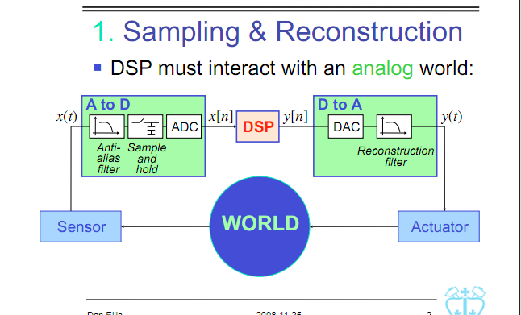
Full process

Slide 18
THE END
PEACE

Slide 19
Works Cited
http://en.wikipedia.org/wiki/Whittaker%E2%80%93Shannon_interpolation_formula
http://www.ee.columbia.edu/~dpwe/e4810/lectures/L11-ctquant-2up.pdf
http://inst.eecs.berkeley.edu/~ee247/fa05/lectures/L17_2_f05.pdf
http://en.wikipedia.org/wiki/Low-pass_filter
http://en.wikipedia.org/wiki/Step_response
http://en.wikipedia.org/wiki/Reconstruction_filter
http://en.wikipedia.org/wiki/Analog-to-digital_converter
http://en.wikipedia.org/wiki/Digital-to-analog_converter
http://en.wikipedia.org/wiki/Nyquist%E2%80%93Shannon_sampling_theorem
http://en.wikipedia.org/wiki/Aliasing

